Slide 1
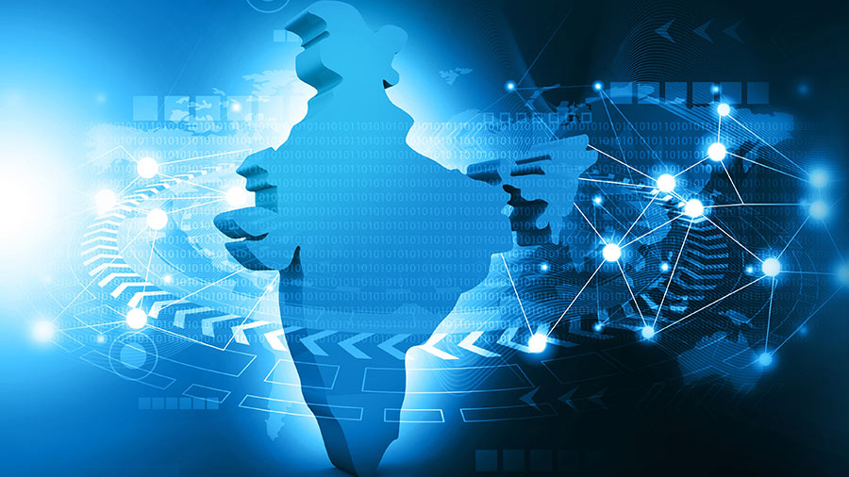

Digital India – Technology for a Better Future
Name- Princy
Trade-AIPA
Institute-NSTI(W), Allahabad
Date-16/09/2026

Slide 2

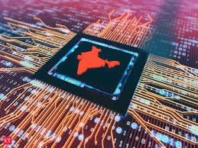
What is Digital India?
Digital services for citizens
Online government services
Digital payments
Digital infrastructure
Technology-enabled education

Slide 3
Digital Payments
E-Governance
Digital Education
Digital Healthcare
Online Banking
Digital Infrastructur
Major Areas of Digital India

Slide 4
Digital Services We Use
Internet
Mobile
Online Services
Digital Payment
Digital Certificate

Slide 5
Digital Payment Method
Payment Method | Example
UPI | Mobile payment
Debit Card | Card payment
Credit Card | Online payment
Net Banking | Bank transfer
QR Code | Scan & Pay

Slide 6
Growth Of Digital Payment

Slide 7

Benefits of Digital Technology
Saves Time
Easy Access
Transparency
Convenience
Wider Connectivity
This Photo by Unknown Author is licensed under CC BY-NC-ND

Slide 8
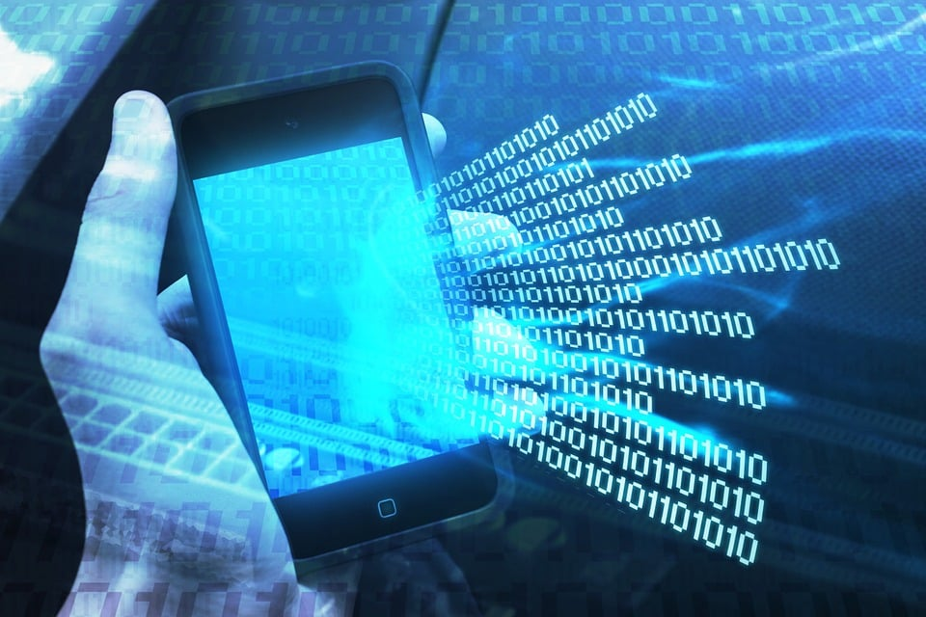
Challenges
🔐 Cybersecurity
🔒 Data Privacy
🌐 Digital Divide
📱 Digital Literacy
⚠️ Online Fraud

Slide 9

Future Of Digital India
Today
Connected Services
Smart Cities
Digital Economy
Future
Timeline

Slide 10
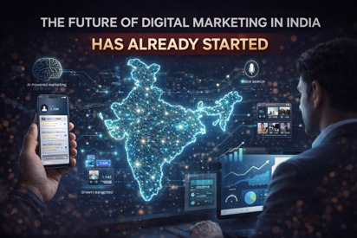
Conclusion
Digital India is transforming the way people live, work, learn, and connect.
With the growth of Artificial Intelligence, Smart Cities, Digital Payments, and Connected Services, India is moving towards a more smart , connected, inclusive, and technology-driven future.
The future of Digital India is not just about technology—it is about creating better opportunities and improving the quality of life for everyone.

Slide 11


